Slide 1


Predictive Maintenance in Solar Power Systems
Team Members
1.M.Mahendiran
2.S.Mohammed Ibrahim
3.M.Kishorekumar
4.A.Arunachaleshwaran
5.M.Gowthaman

Slide 2
Content
Abstract
Problem Statement
Objective
Data Collection and Preparation
Proposed Solution (Methodology)
Model Performance Evaluation
Screenshots / Demonstration (video)
Future Scope
Conclusion
Notes:
Abstract
Problem Statement (Clearly define the challenge)
Objective (State your project's goal)
Background and Research (Discuss existing solutions, trends, and gaps)
Data Collection and Preparation (Focus on data sources, cleaning, and augmentation)
Proposed Solution (Methodology)
Model Architecture (e.g., CNN, U-Net, YOLOv5)
Key Techniques (e.g., Transfer Learning, Image Augmentation)
Model Performance Evaluation
Metrics (Accuracy, Precision, Recall, IoU, etc.)
Graphs (Confusion Matrix, ROC Curve, etc.)
Screenshots / Demonstration (Visual proof of system functionality)
Future Scope (Improvements, scalability, and integration ideas)
Conclusion (Summarize results and impact)
Q&A Session

Slide 3
Abstract
This case study focuses on implementing AI-driven predictive maintenance in solar power systems. It highlights how data from sensors can be used to predict potential equipment failures, particularly inverters, leading to improved efficiency, reduced downtime, and cost savings.

Slide 4
Problem Statement
Traditional maintenance of solar farms follows scheduled intervals, which often leads to over or under Maintenance. Inverter failures in solar farms can cause significant energy losses, especially during peak hours. An intelligent system is needed to predict failures before they occur.

Slide 5
Objective
Traditional maintenance of solar farms follows scheduled intervals, which often leads to over or under maintenance. Inverter failures in solar farms can cause significant energy losses, especially during peak hours. An intelligent system is needed to predict failures before they occur.

Slide 6
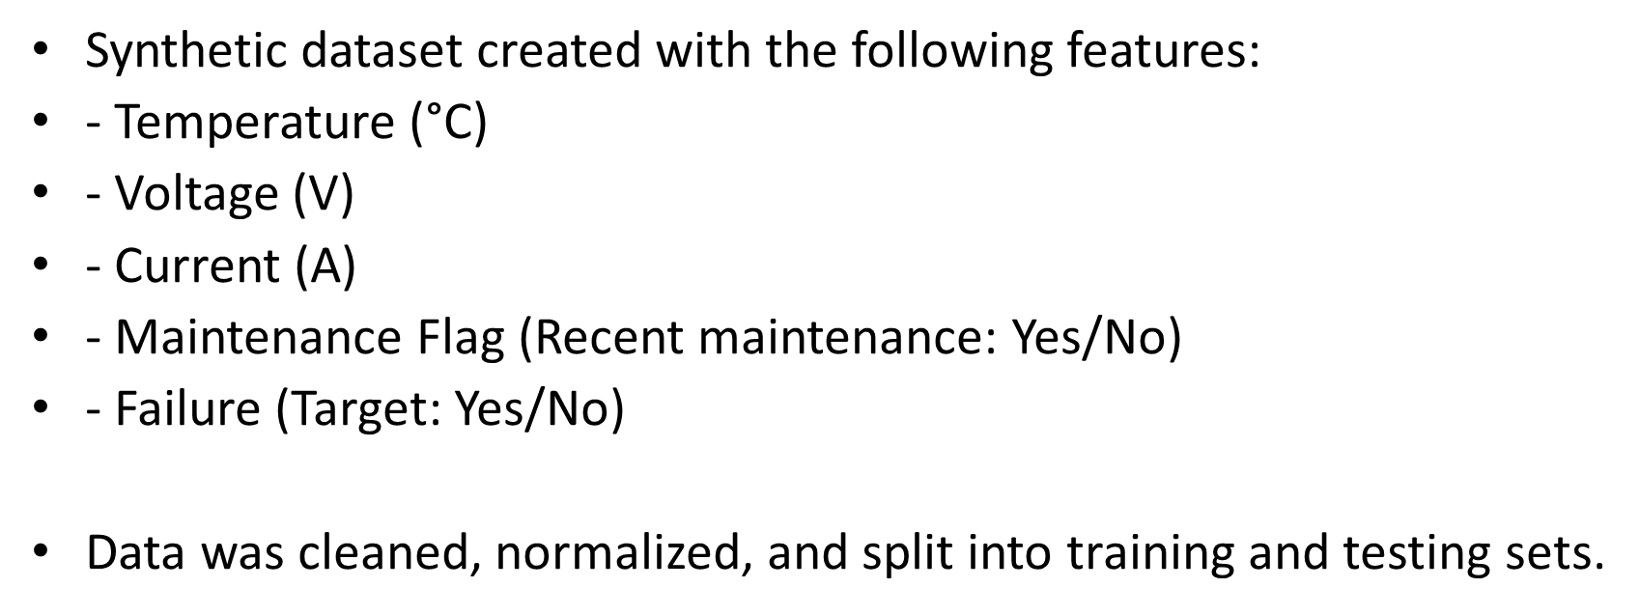
Data Collection and Preparation

Slide 7
Proposed Solution (Methodology)
1. Collected and preprocessed sensor and maintenance data.
2. Built a Random Forest Classifier to model failure prediction.
3. Trained the model on 80% of the data.
4. Evaluated the model on the remaining 20% test data.
5. Used feature importance analysis to refine predictions.

Slide 8
Model Performance Evaluation
The model was evaluated using:
- Accuracy
- Confusion Matrix
- Classification Report (Precision, Recall, F1 Score)
Accuracy achieved: ~90%
Feature importance indicated temperature and current were the most predictive features.

Slide 9
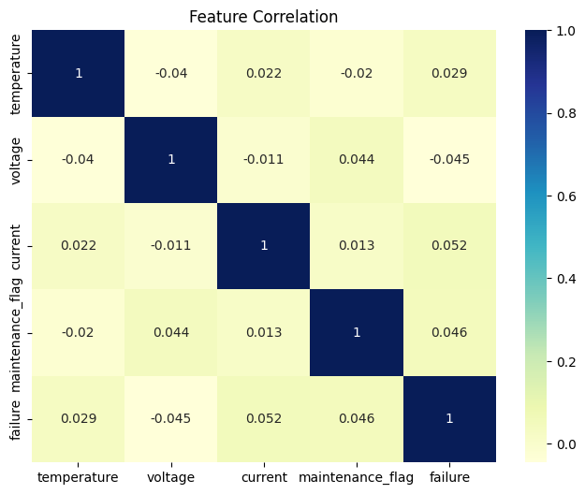
Screenshots
Colab link : https://colab.research.google.com/drive/13ZRHBAlkaB7WcPeRefqdttruQc54MJjR#scrollTo=ahAtEYvInhDc
Github link : https://github.com/magendiran933/Per131_S4F_CP_Team_11924/upload/main

Slide 10
Future Scope
1.Incorporate weather and irradiance data.
2. Use time-series deep learning models (e.g., LSTM).
3. Real-time failure alerts via IoT devices.
4. Integrate with solar farm management systems for automatic maintenance scheduling.

Slide 11
Conclusion
The implementation of AI in predictive maintenance for solar power systems can significantly enhance performance. Using machine learning, potential failures can be anticipated, reducing energy losses and improving overall reliability and cost-efficiency.

